Slide 1
Lab Meeting
Presenter: 109368093 梁有騰
2021.08.12

Slide 2
TensorFlow vs. Keras
TensorFlow is a machine learning model build by C++, it can help user to train a machine learning model.
Keras is a package that can help users to invoke TensorFlow easier.
The functions Keras provided can help user to create and train a NN model easier.

Slide 3
TFDS
TFDS is a python model that can help use to get datasets.
Install TFDS with pip.
pip install tensorflow-datasets.
Using load() to load a data set
tfds.load(‘fashion_mnist’)

Slide 4
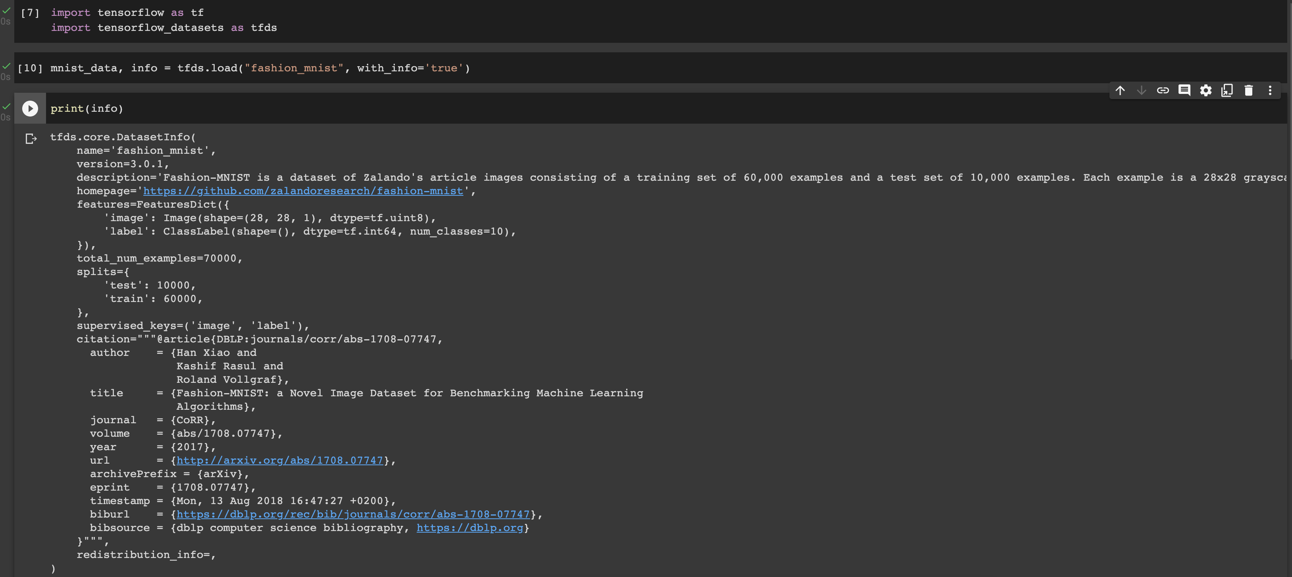
TFDS (Cont’d)

Slide 5
Natural Language Processing (NLP)
NLP is a subfield of AI, the main purpose is make the computer can recognize the natural language.
NLP can let computers able to understand, analyze and create the natural language.
If our AI model can understand NL, it means our AI is able to replay you or do some works according to your commands.
Furthermore, if AI model can understand NL, we can build a algorithm to detect the emotion of sentences or text.

Slide 6
Tokenization
We can replace the words with number in a sentence.
“I love dog” = [0, 1, 2, 3]
“I love cat” = [0, 1, 2, 4]
“I love a cat” = [0, 1, 2, 5, 4]

Slide 7
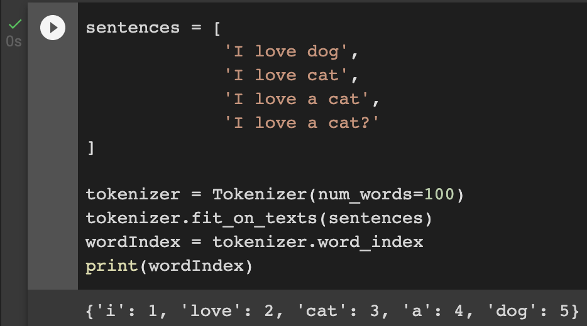
Tokenization (Cont’d)

Slide 8
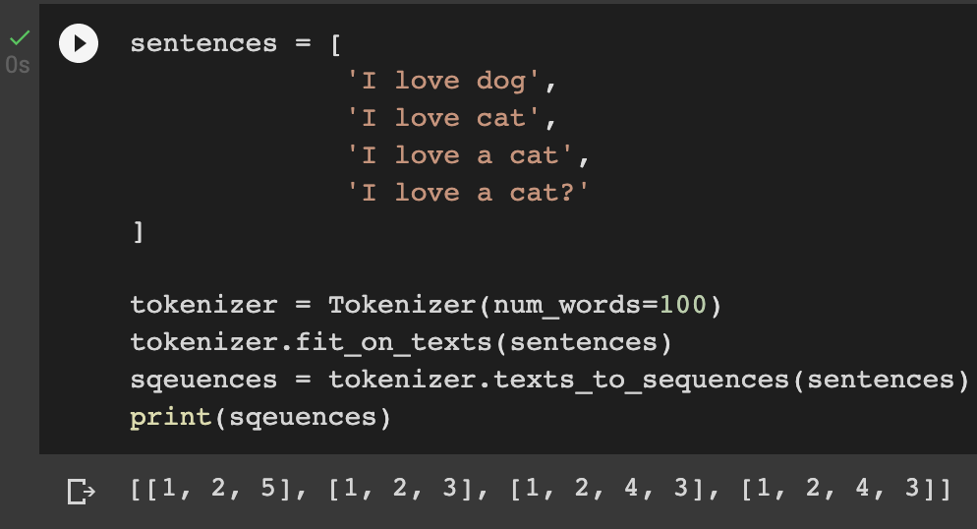
Texts to Sequences

Slide 9
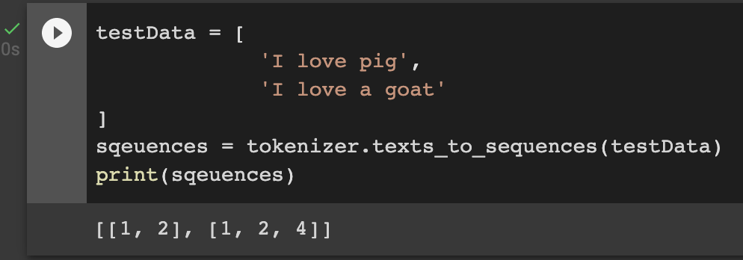
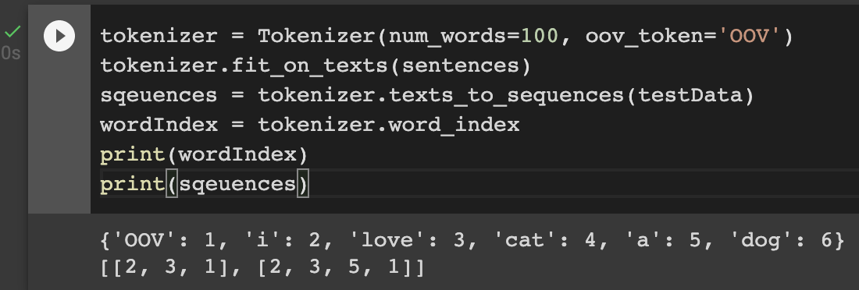
Out of Vocabulary (OOV)
OOV means your algorithm can’t understand the word, it means this word doesn’t exist in the vocabulary.

Slide 10
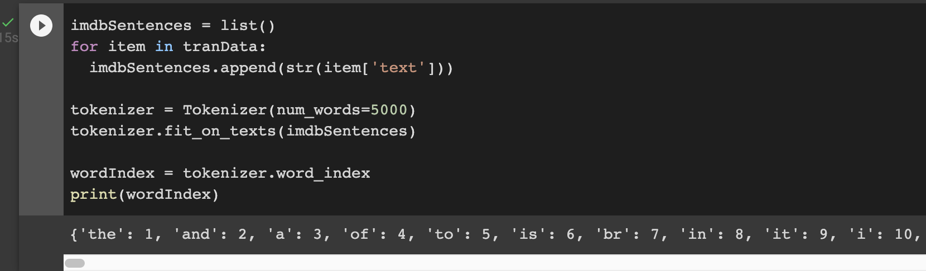
Get Texts from TensorFlow
We can get the texts from TensorFlow.

Slide 11
Sarcasm Detection
From now on, we will start to build a model for sarcasm detection.
We will use the NLP analyzing skills we learned before to build a ML model.
The format of example dataset is *.json, but the format for practice data set will be *.csv, please try to load it into python and use it to train your own model.

Slide 12
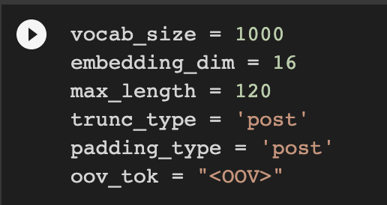
Parameters Declaration
These parameters will be use during our model defining part, you can try to set it to different value and observe the differences.

Slide 13
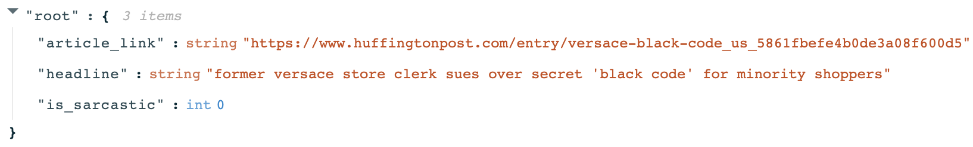
Sarcasm Dataset
The following is the format of the sarcasm dataset as .json file, you should load and categorize all data as well.

Slide 14
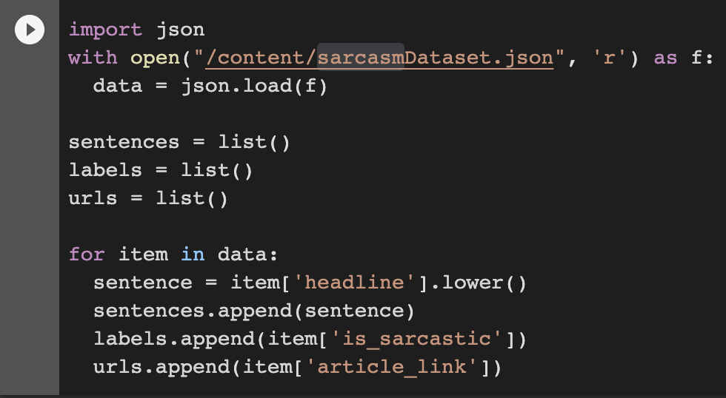
Load the Dataset
The following is the process of loading dataset form .json file, you can try to use the similar process for .csv file.

Slide 15
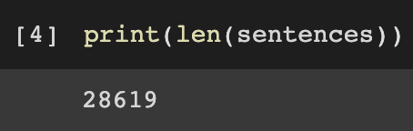
Amounts of Data
We can use len() to observer the size of data that intended to train.
Obviously, len() says we have 28619 data loaded from .json dataset.

Slide 16
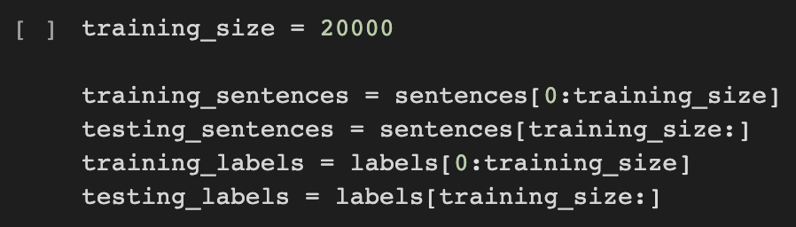
Split Dataset into Training and Testing
Since the dataset didn’t provide us the testing data, we should split it from origin dataset ourself.
We choose 20000 data for training and 8619 for testing.

Slide 17
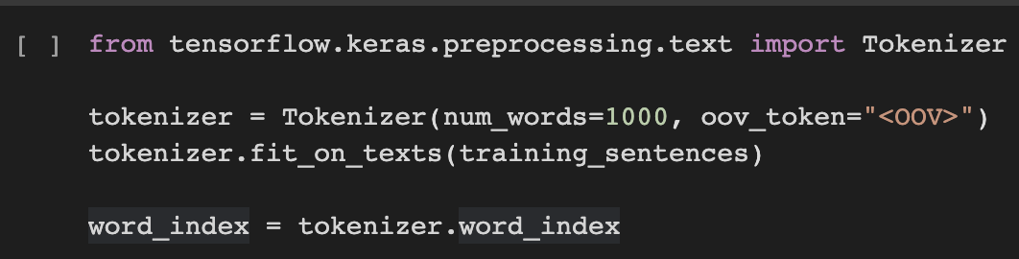
Tokenizing the Data

Slide 18
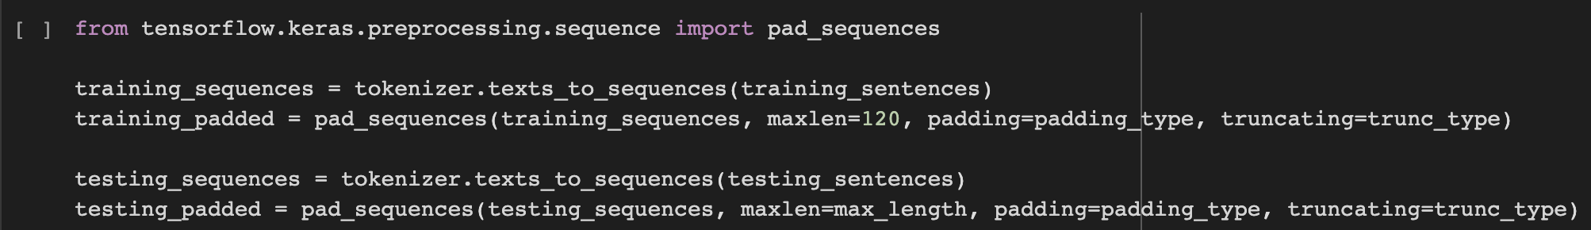
Pad Sequences

Slide 19
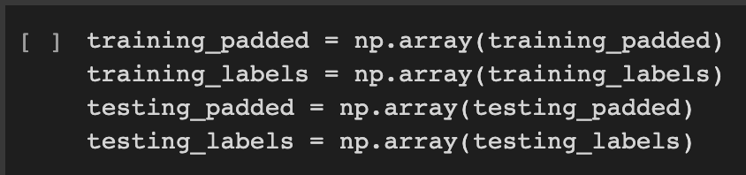
Turn the Data into Numpy Array

Slide 20
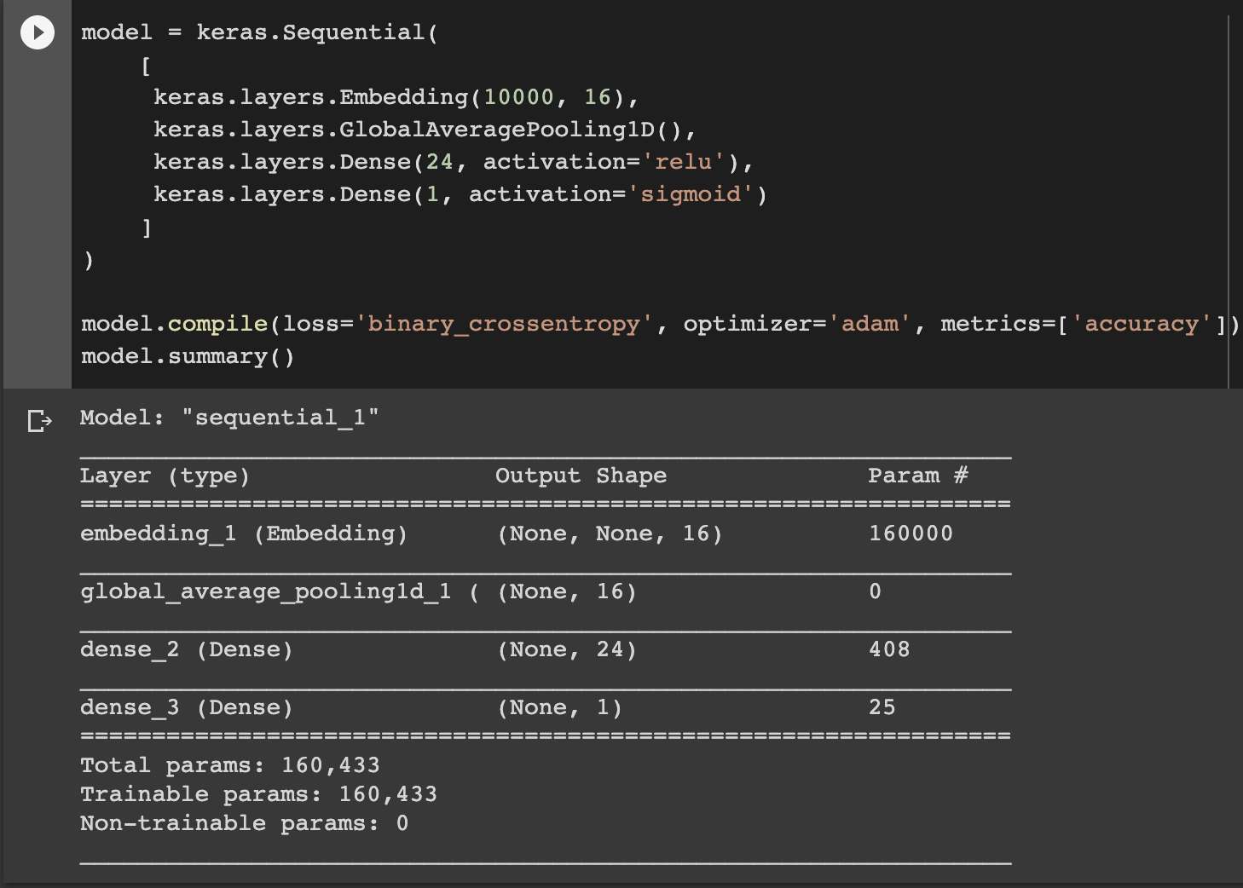
Building the Model

Slide 21
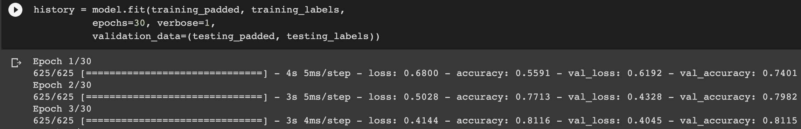
Training the Model

Slide 22
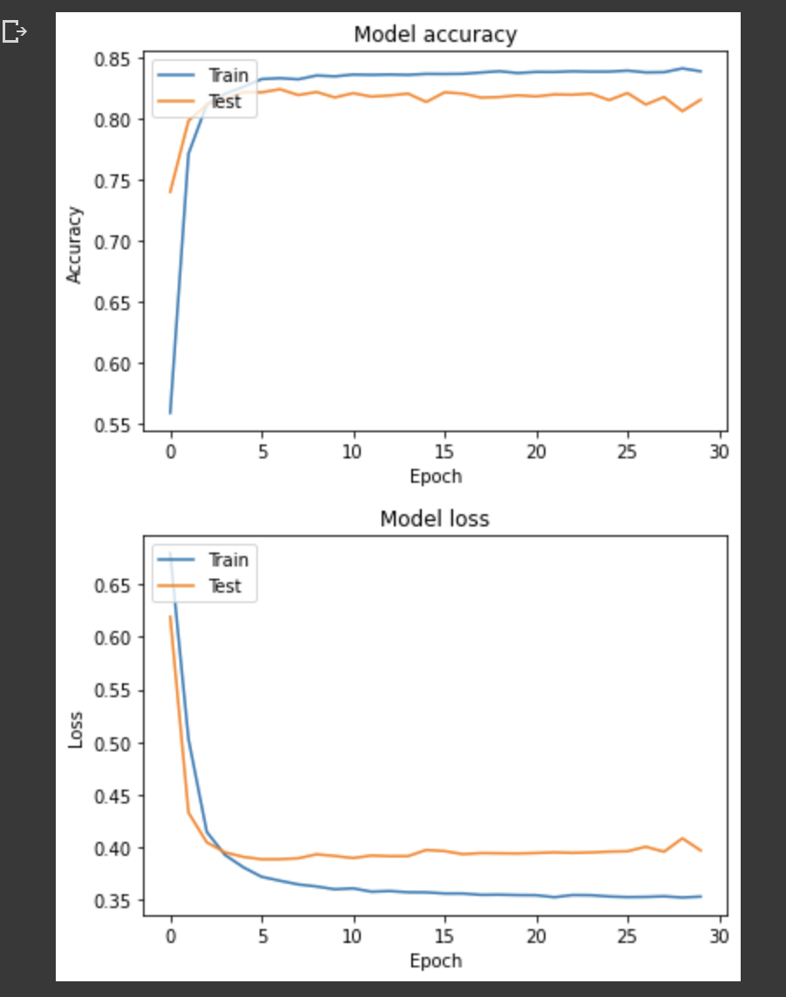
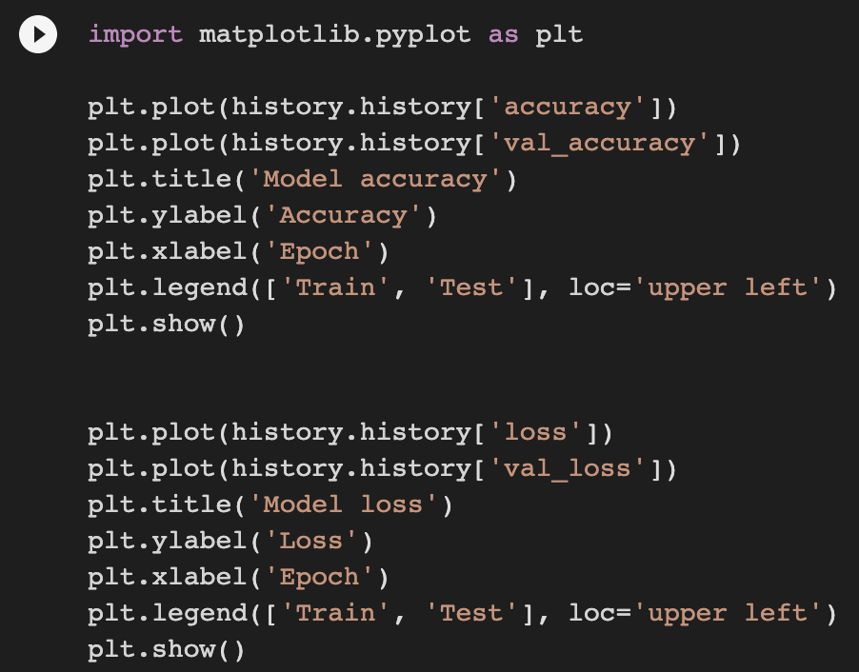
Plotting the Result

Slide 23
Improve our model
After we know how to train our model, next step is to improve it.
We will try these ways to improve our model:
Increase the training epochs.
Use another NN for training.
Increase the amounts of data.
Use pre-trained model.
Improve the optimizer.

Slide 24
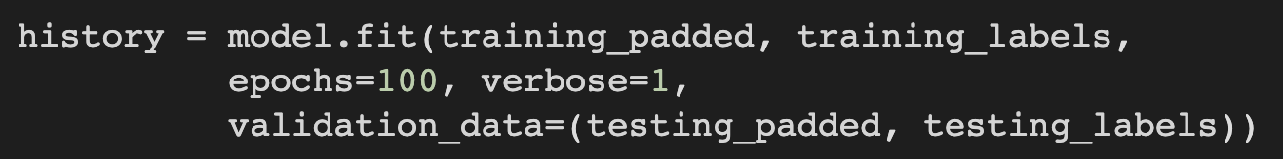
Improve the Epochs
The simplest way to try is improve the training epochs.
For example, increase from 30 to 100.

Slide 25
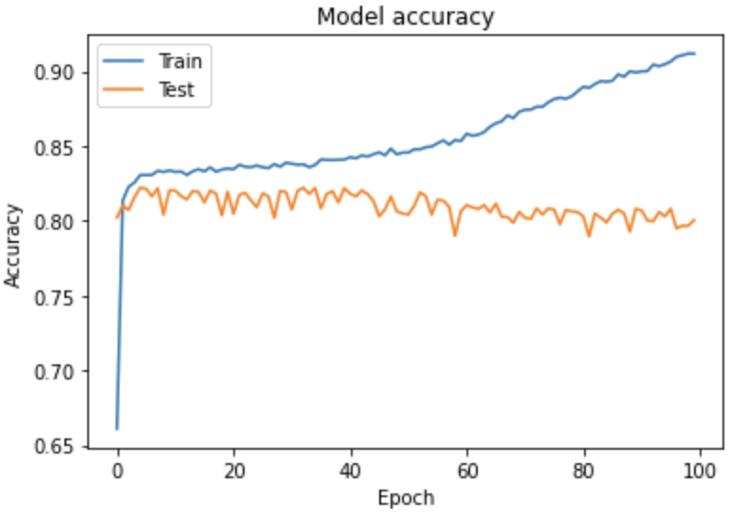
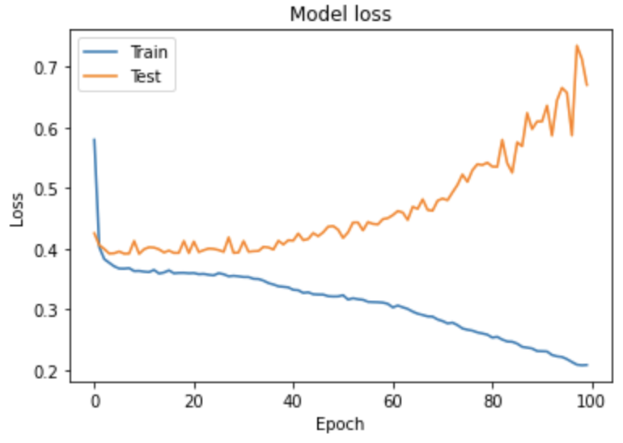
Improve the Epochs (Cont’d)
Let’s see the results.

Slide 26
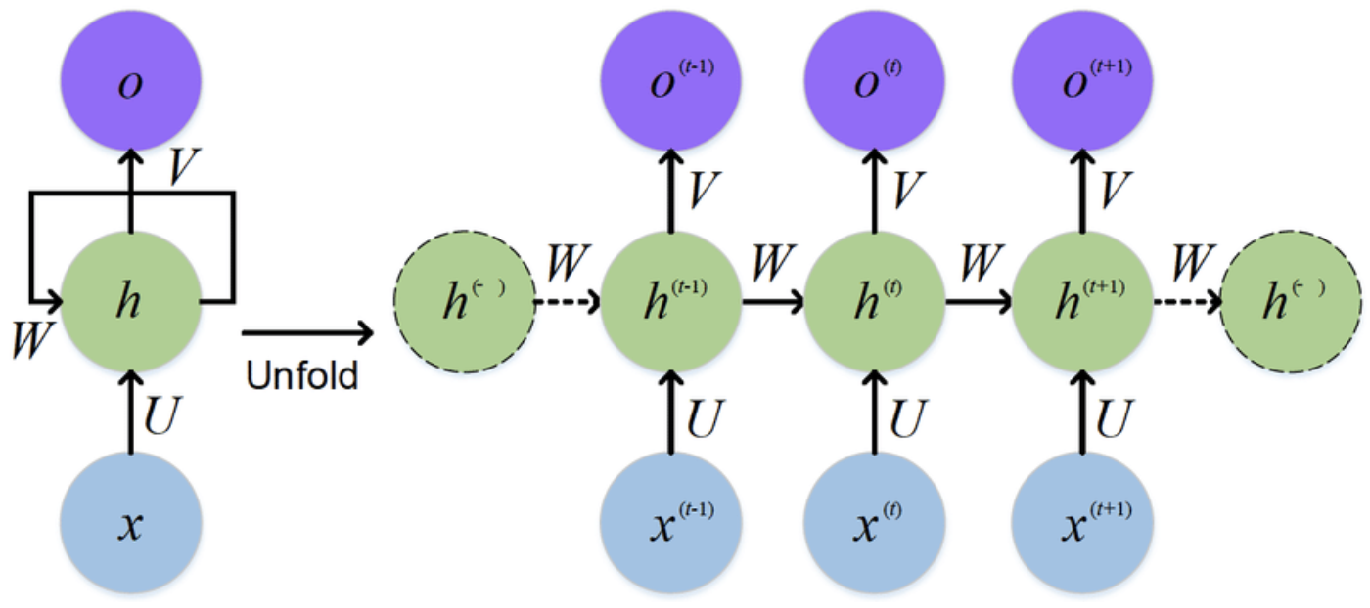
RNN
RNN means recursively neural network.
RNN is one of the popular NN models, the characteristic is RNN will re-train the model with new data.
https://www.researchgate.net/figure/The-standard-RNN-and-unfolded-RNN_fig1_318332317

Slide 27
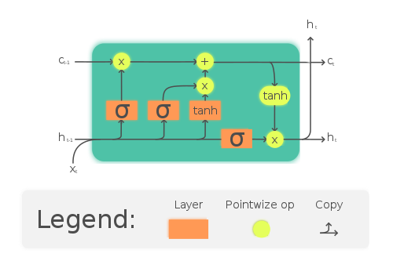
Long Short Term Memory
LSTM is the most popular implementation of RNN.
The simple way to understand LSTM is:
It will re-train the data with new data.
It will dropout the data that is not important.
It has a gate to determine if the data can be output to next layer.

Slide 28
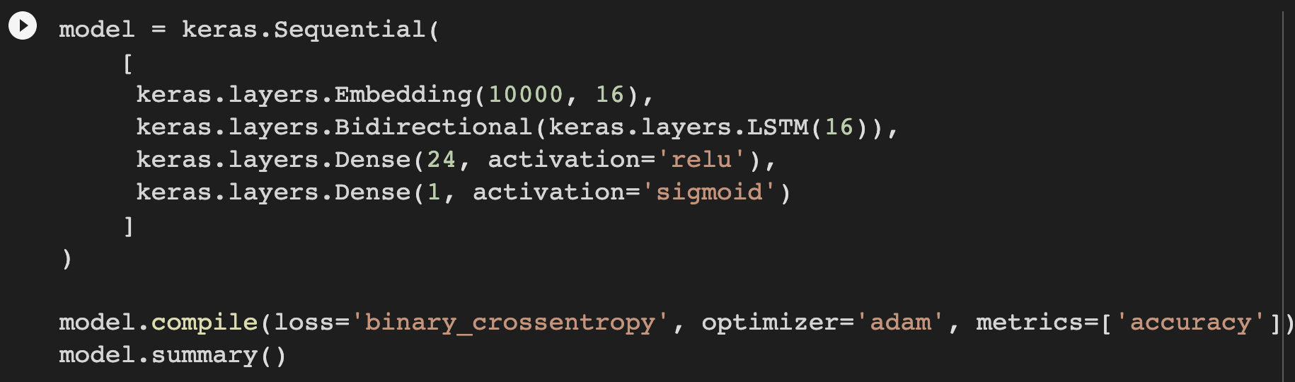
Training Model with LSTM
We can use the build-in LSTM layer of Keras to train our model.

Slide 29
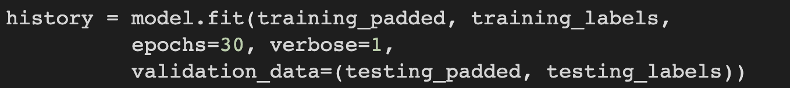
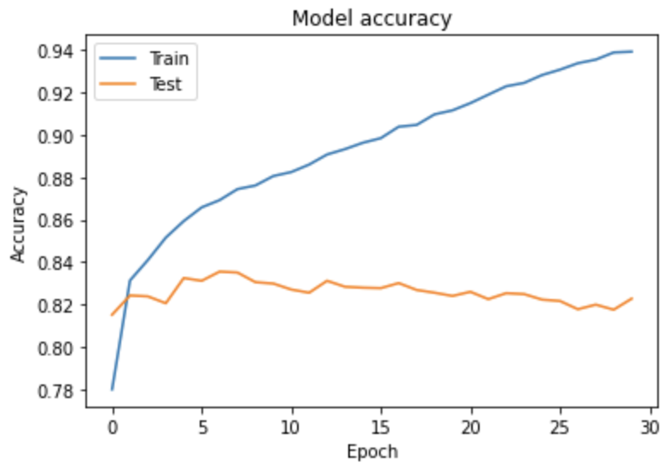
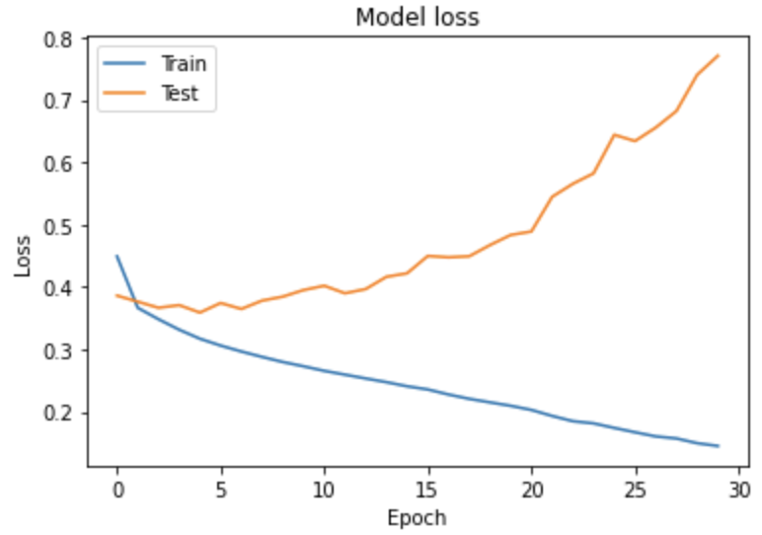
Training Model with LSTM
Let’s see the results.

Slide 30
Overfitting
Overfitting is a problem that will happened during training your model.
You can simply understanding it like:
When you are studying math.
You just memorize all the answers on your textbook.
You will fall when the problem of exam has a little bit different.
Same, if your model just memorize all the answers, how it will be if the text data has all bit change ?

Slide 31
Overfitting (Cont’d)
So, how do we fix the overfitting problem ?
The most simple way is to use the pre-trained models.
Normally, pre-trained models already have the best weights, we just need to invoke it and add it into our model.

Slide 32
Pre-trained Model
The pre-trained model we will use is tf2-preview/gnews-swivel-20dim.
It is the pre-trained model provided by Google.
This pre-trained model has 130GB corpus of English Google News.
You can see the detailed information in this website.
https://tfhub.dev/google/tf2-preview/gnews-swivel-20dim/1

Slide 33
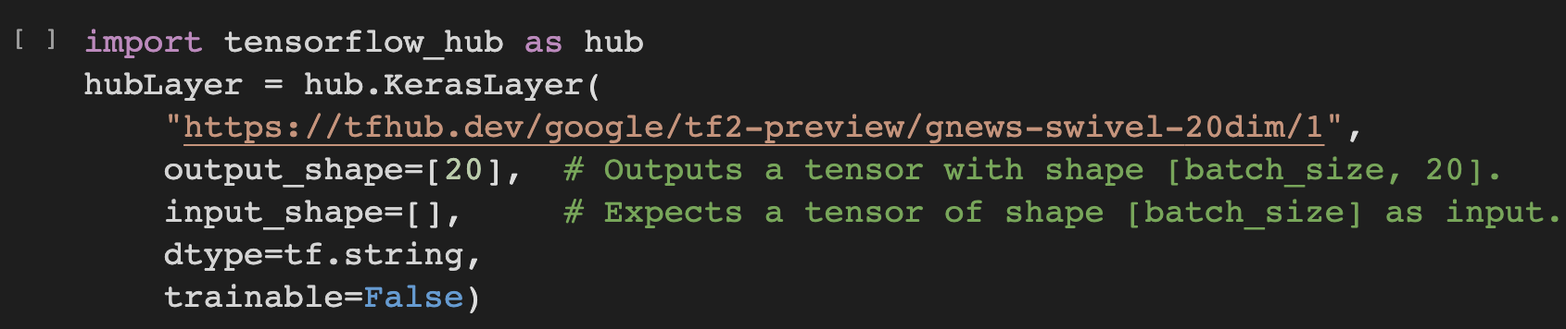
Pre-trained Model (Cont’d)
Now we are trying to invoke the pre-trained model.
Luckily, this pre-trained model is included in TensorFlow Hub.

Slide 34
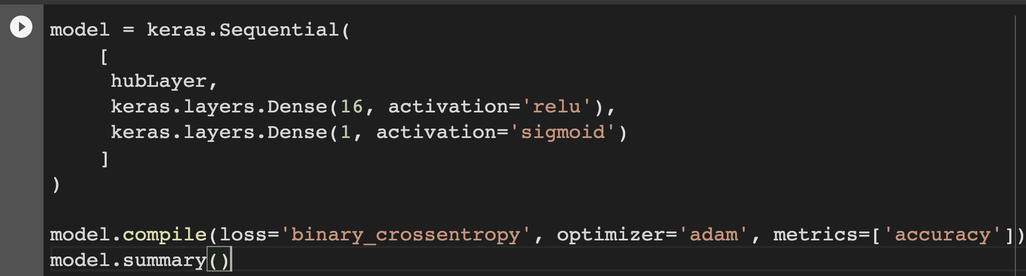
Training the Data with Pre-trained Model

Slide 35
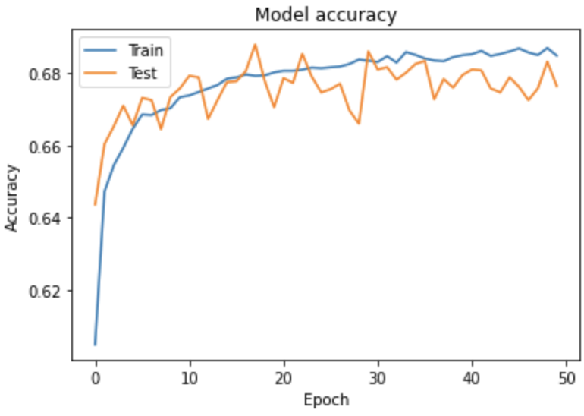
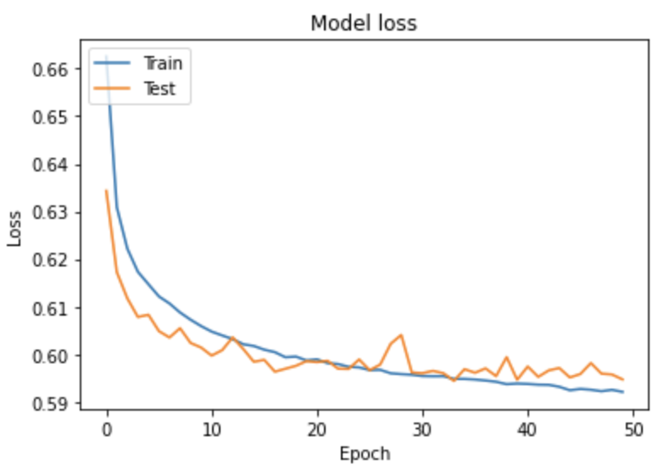
Training Results

Slide 36
Training Results (Cont’d)
We can see that, the overfitting problem is fixed.
But seems the accuracy is not so good.
The accuracy is under 70%.

Slide 37
Training with More data
Since the data we have is not enough.
We should standing on the shoulders of giants.
Let’s use GloVe to train our model.
GloVe collects more than 2B tweets on Twitter.
The dataset more than 1.4 GB !

Slide 38
Download GloVe Dataset
We can download the dataset with a simple Linux command.
Or, you can download it via this link.
https://huggingface.co/stanfordnlp/glove/resolve/main/glove.twitter.27B.zip

Slide 39
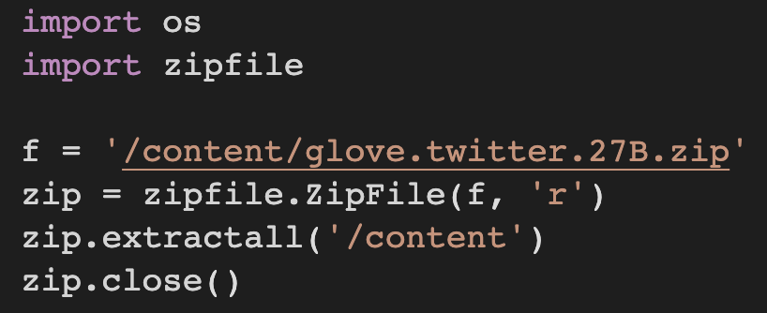
Unzip the dataset

Slide 40
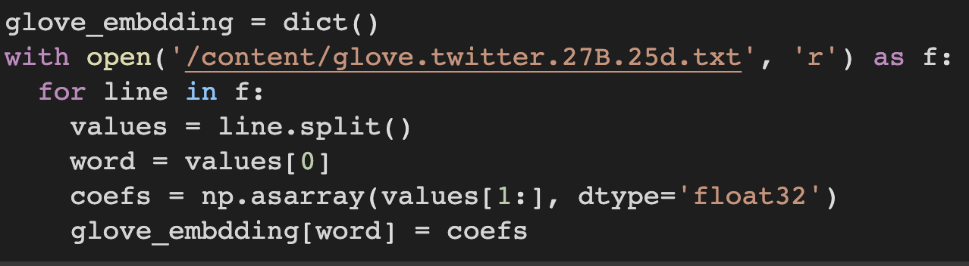
Load the Data
Now, let’s try to load the data from the dataset.
We choose to use 27B.25d.text this file.
It means it has 27B of tokens and each tokens has 25 dimensions.

Slide 41
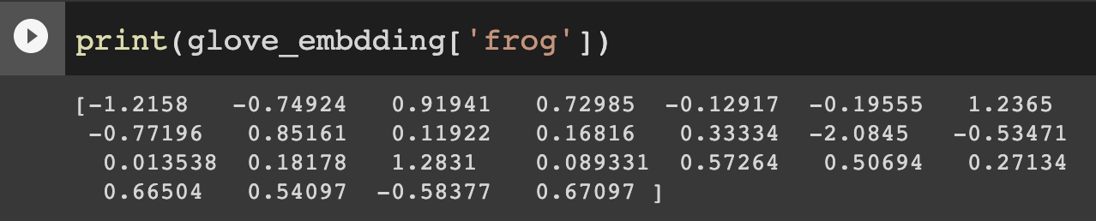
Try to Print the Coefficients
After we loaded the data, we can try to print the coefficients.

Slide 42
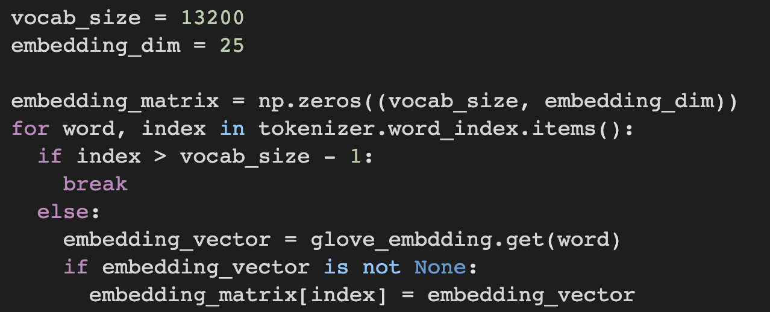
Filter the Data
Since this dataset is too large, it will take lots of time for training.
We just take what we need.

Slide 43
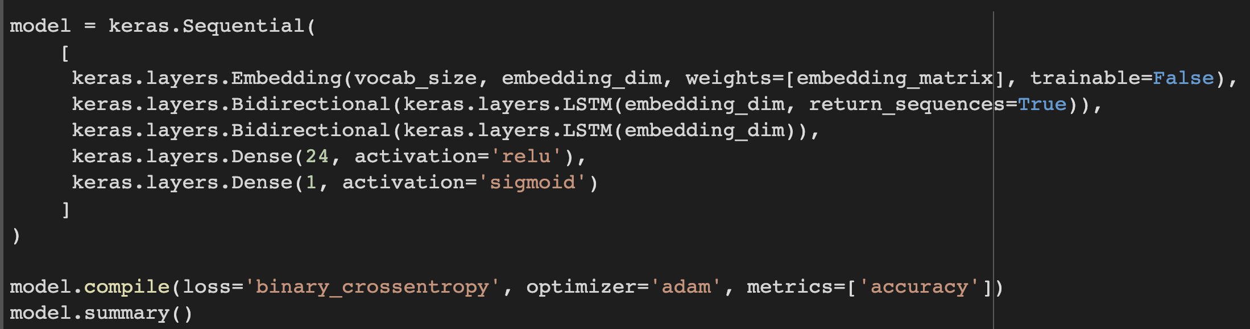
Preparing the Model

Slide 44
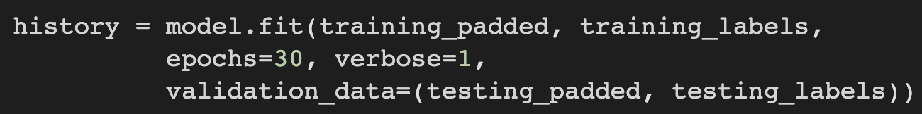
Training the Model
First, we juts train it with 30 epochs to see the results.

Slide 45
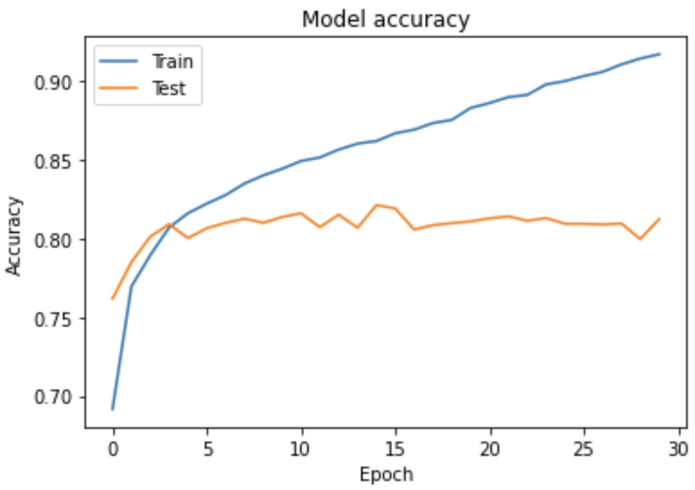
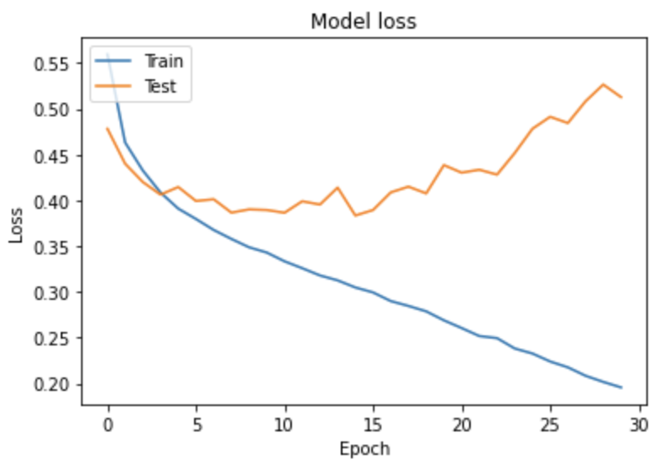
Results
Well, I don’t like the results.

Slide 46
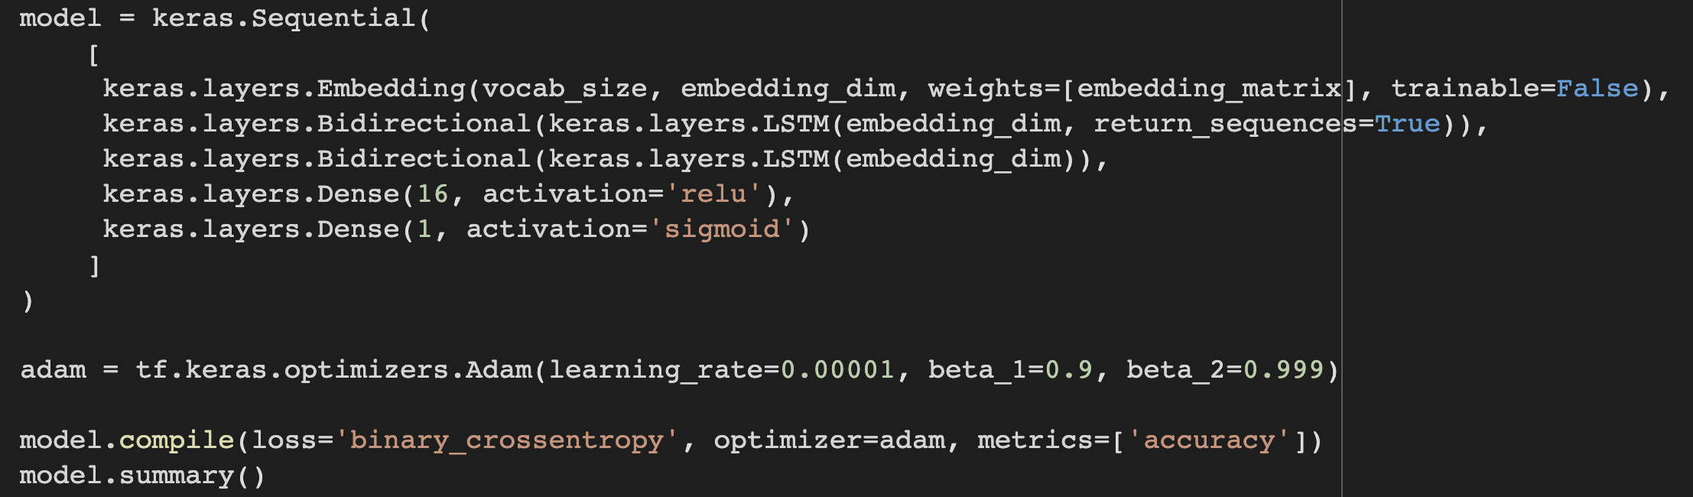
Optimizer
Don’t worry, we still have the last skill.
Modify the optimizer.

Slide 47
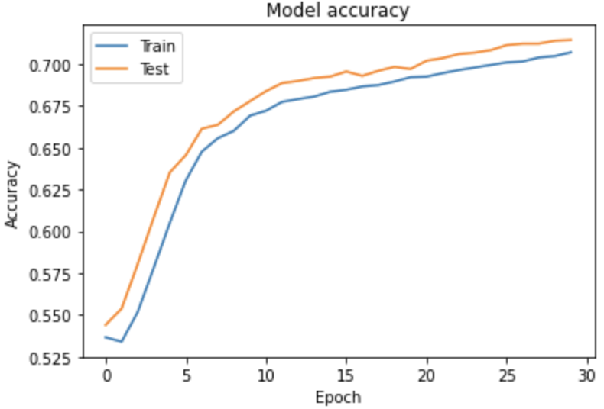
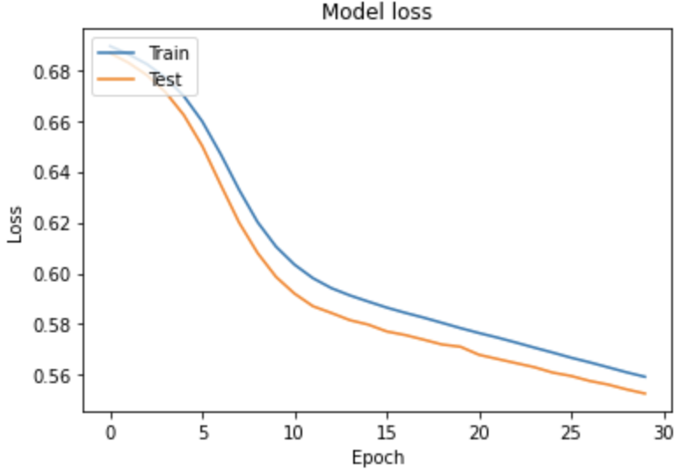
Results
Please enjoy the results for 30 epochs.

Slide 48
Underfitting
Underfitting means your model can do better.
Now, you should increase the epochs or the layer amounts to exploit the model.

Slide 49
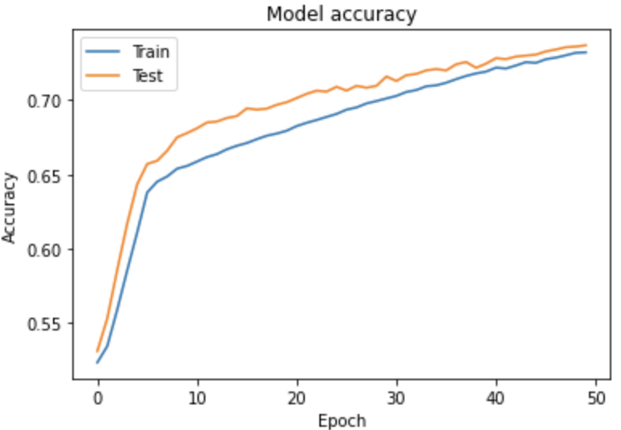
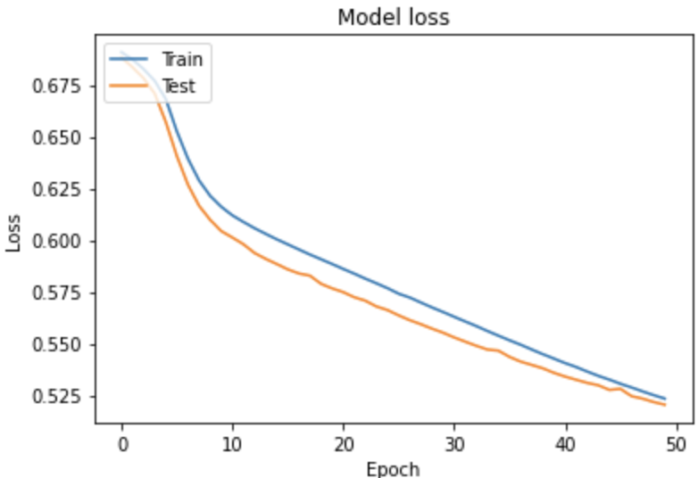
Results of 50 Epochs

Slide 50
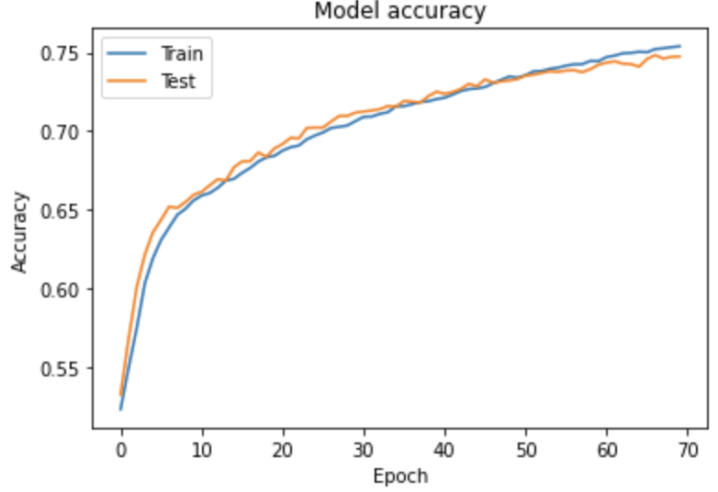
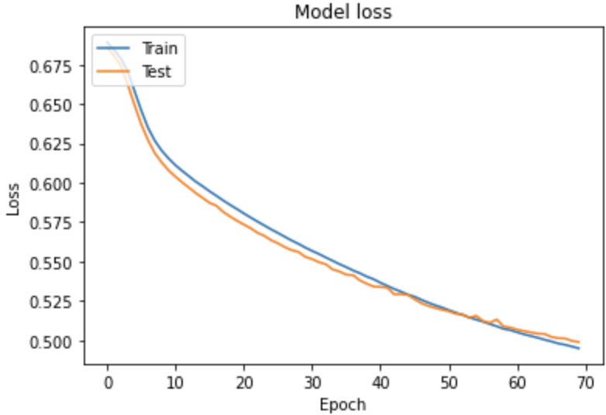
Results of 70 Epochs

Slide 51
Results
Seems 50 epochs is the best solution.
Next step is to save our model.

Slide 52
Save the Model

Slide 53
Using Saved Model to Predict

